Slide 1

Thermodynamics and kinetics
Thermodynamic laws
Half-cell reactions
Kinetics
Acid-Base
Equilibrium calculations
  Speciation calculation from complexation constants
Provide review of concepts for applications to radiochemistry

Slide 2
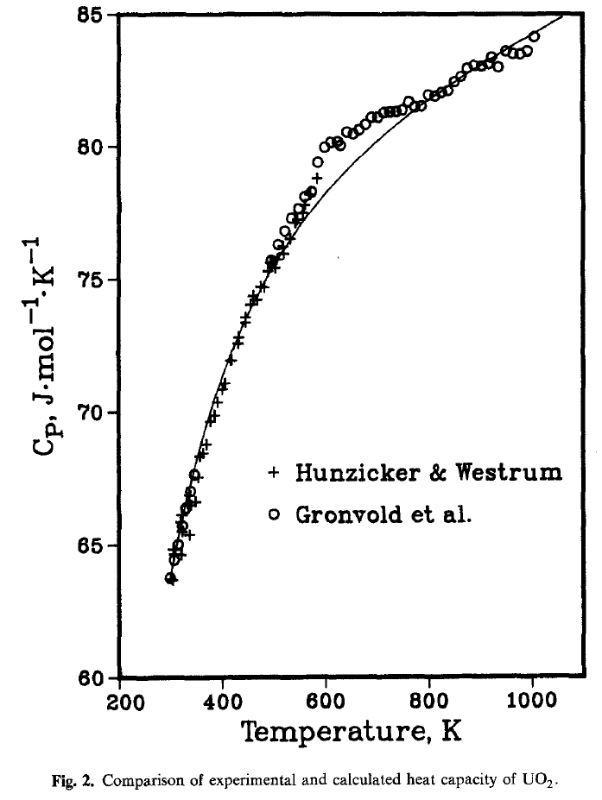
Thermodynamic terms
Heat Capacity (C_{p})
  Heat required to raise one gram of substance 1 °C
  Al; C_{p} = 0.895 J/gK
    1 cal = 4.184 J
  What is the heat needed to increase 40 g of Al by 10 K
  (0.895 J/gK)(40g)(10K)= 358 J
Exothermic
  Reaction produces heat (at 25 °C)
  C(s) + O₂(g) <--> CO₂(g) + 393.76 kJ

Slide 3
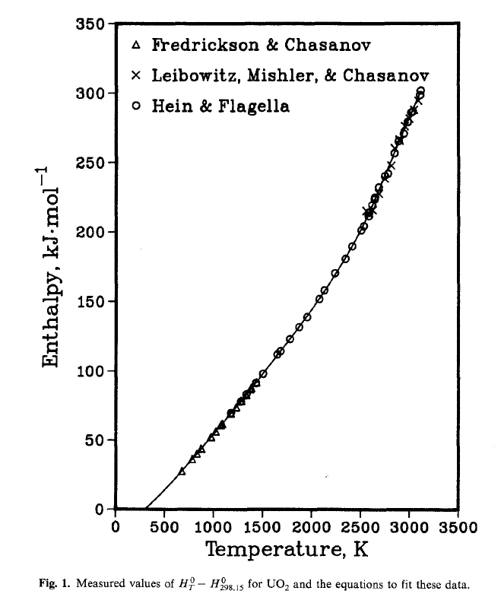
Thermodynamic terms
Endothermic
  Reaction requires energy (at 25 °C)
  2 HgO + 181.70 kJ <--> 2 Hg + O₂
Enthalpy (∆H)
Energy of a system (heat content)
  Internal energy, volume, pressure
  Accounts for energy transferred to environment by expansion or heating
∆H = ∆H_{products} - ∆H_{reactants}
Exothermic reactions, negative ∆H
  Negative ∆H tend to be spontaneous

Slide 4
Enthalpy (∆H)
Bond energies
  Can be used to estimate ∆H
  N₂ + 3 H₂ <--> 2 NH₃
  6(351.5)-945.6-3(436.0) = -144.6 kJ/2 mole
  =-72.3 kJ/mole (actual -46.1 kJ/mol)
Aqueous Ions (use ∆H values, databases available for different states)
  ∆H_{products}⁻∆H_{reactants}
    2 H⁺ + CO₃²⁻ <--> CO₂ + H₂O
    -393.5 + (-285.8)-(-677.1+2(0)) = -2.2 kJ/mol
CO_{2(g)}
H₂O_{(l)}
CO₃²⁻
H⁺

Slide 5
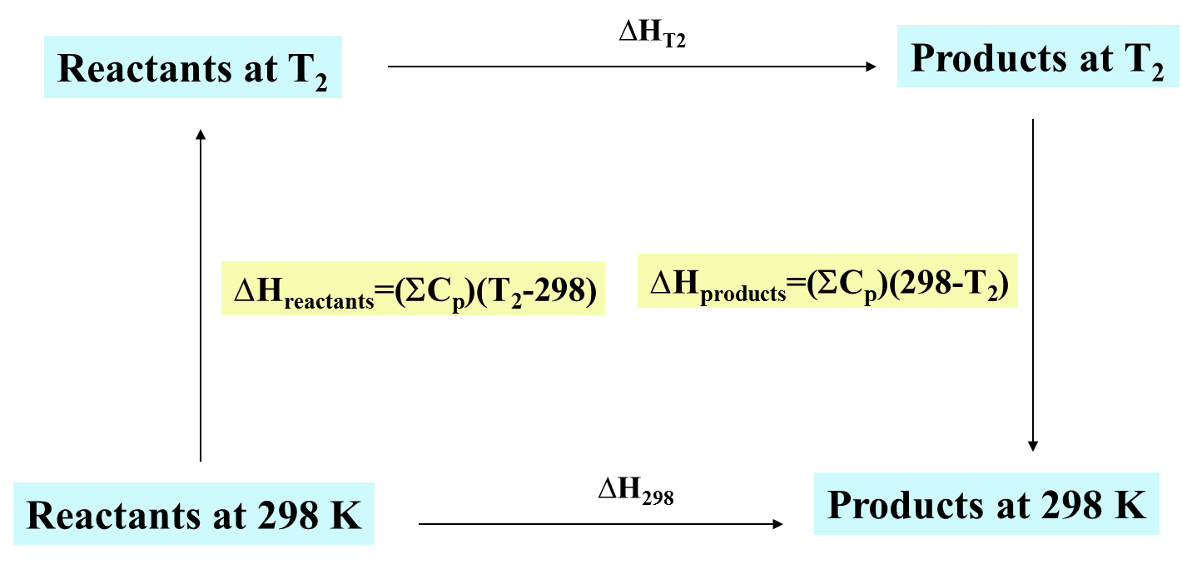
∆H determination
Standard Solution
Ag+ 105.579
AgCl₂⁻ -245.2
Ag(NH₃)²⁺ -111.29
Ag(S₂O₃)₂⁻ -1285.7
Al³⁺ -531
Br- -121.55
BrO₃- -67.07
Ca²⁺ -542.83
Cd²⁺ -75.9
Cd(CN)₄²⁻ 428
Cd(NH₃)₄²⁺ -450.2
Ce³⁺ -696.2
Ce⁴⁺ -537.2
CH₃COO- -486.01
CH₃COOH -485.76
CN- 150.6
CNS- 76.44
Cl- -167.15
ClO₄- -129.33
CO₂ -413.8
CO₃²- -677.14
H+ 0
H₂O₂ -191.17
I- -55.19
I₃- -51.5
IO₃- -221.3
K+ -252.38
NH₃ -80.29
NH₄+ -132.51
NO₃- -205
Na+ -240.12
OH- -229.99
O₂ -11.7
SO₄²- -909.27
Sn²⁺ -8.8
Sr²⁺ -545.8
Tl³⁺ 196.6
U⁴⁺ -591.2
UO₂²⁺ -1019.6
ΣC_{p} is the sum of the heat capacities
Pure substance
CaC₂O₄(c) -1360.6
CaF₂(c) -1219.6
Ca₃(PO₄)₂(c) -4109.9
CaSO4(c,anhydrite) -1434.1
Cd(g) 2623.54
Cd²⁺(g) 112.01
Cd(OH)₂(c) -560.7
CdS(c) -161.9
Cl(g) 121.679
Cl-(g) -233.13
ClO₂(g) 102.5
Cu(g) 338.32
Cu₂O(c,cuprite) -168.6
CuO(c,tenorite) -157.3
Cu(OH)₂(c) -449.8
Cu2S(c,chalcocite) -79.5
CuS(c,covellite) -53.1
F(g) 78.99
F-(g) -255.39
Fe(g) 416.3

Slide 6
Entropy (∆S) and Gibbs Free Energy (∆G)
Randomness of a system
  increase in ∆S tends to be spontaneous
Enthalpy and Entropy can be used for evaluating the free energy of a system
Gibbs Free Energy
  ∆G = ∆H -T∆S
  ∆G=-RTlnK
    K is equilibrium constant
    Activity at unity
Compound ∆G° (kJ/mol) at 298.15 K
H₂O -237.129
OH⁻_{(aq)} -157.244
H⁺_{(aq)} 0
H₂O←→H⁺+OH⁻
  What is the constant for the reaction?
    Products-reactants
At 298.15 K
  ∆G(rxn) = 0 + -157.244 - (-273.129) = 79.9 kJ/mol
  lnK= (79.9E3/(-8.314*298.15))=-32.2; K=1E-14, K_{w} = [H⁺][OH⁻]

Slide 7
Thermodynamic Laws
1st law of thermodynamics
  Energy is conserved in a system
    Can be changed or transferred
  Heat and work are energy transfer
    ∆E = q (heat absorbed) + w (work)
2nd law of thermodynamics
  Reactions tend towards equilibrium
    Increase in entropy of a system
  Spontaneous reaction for -∆G
    ∆G = 0, system at equilibrium
3rd law of thermodynamics
  Entropies of pure crystalline solids are zero at 0 K
  Defines absolute zero

Slide 8
Redox Reactions: Faraday Laws
In 1834 Faraday demonstrated quantities of chemicals which react at electrodes are directly proportional to charge passed through the cell
  96487 Coulomb (C) is the charge on 1 mole of electrons = 1F (faraday)
Cu(II) is electrolyzed by a current of 10 A (C/s) for 1 hr between Cu electrode
  How much Cu reacts
anode: Cu <--> Cu²⁺ + 2e⁻
cathode: Cu²⁺ + 2e⁻ <--> Cu
  Number of electrons
    2 from redox reaction
      (10A)(3600 sec)/(96487 C/mol) = 0.373 F
      0.373 mole e⁻ (1 mole Cu/2 mole e⁻) = 0.186 mole Cu

Slide 9
Half-cell potentials
Standard potential
  Defined as ε°=0.00 V for
    H₂(atm) <--> 2 H⁺ (1.000M) + 2e⁻
Other reactions compared to H₂
Cell reaction for
  Zn and Fe^{3+/2+} at 1.0 M
  Write as reduction potentials
    Fe³⁺ + e⁻ <--> Fe²⁺ ε°=0.77 V
    Zn²⁺ + 2e⁻ <-->Zn ε°=-0.76 V
      Reduction potentials are available http://www.csudh.edu/oliver/chemdata/data-e.htm
Reduction potential for Fe³⁺ is larger
  Fe³⁺ is reduced, Zn is oxidized in reaction

Slide 10
Half-Cell Potentials
Overall balanced equation
  2Fe³⁺ +Zn <--> 2Fe²⁺ + Zn²⁺ ε°=0.77+0.76=1.53 V
Use standard reduction potential
Half cell potential values are not multiplied
  ε° is for a mole of electrons
Application of Gibbs Free Energy
If work is done by a system
  ∆G = -ε°nF (n= e⁻)
Find ∆G for Zn/Cu cell at 1.0 M
  Cu²⁺ + Zn <--> Cu + Zn²⁺ ε°=1.10 V
  2 moles of electrons (n=2)
    ∆G =-2(96487C/mole e⁻)(1.10V)
    ∆G = -212 kJ/mol

Slide 11
Nernst Equation
Compensated for non unit activity (not 1 M)
Relationship between cell potential and activities
aA + bB +ne⁻ <--> cC + dD
At 298K 2.3RT/F = 0.0592
What is potential of an electrode of Zn(s) and 0.01 M Zn²⁺
Zn²⁺ +2e⁻ <--> Zn ε°= -0.763 V
activity of metal is 1

Slide 12
Kinetics and Equilibrium
Kinetics and equilibrium important concepts in examining and describing chemistry
  Identify factors which determine rates of reactions
    Temperature, pressure, reactants, mixing
  Describe how to control reactions
  Explain why reactions fail to go to completion
  Identify conditions which prevail at equilibrium
Rate of reaction
  Can depend upon conditions
Free energy does not dictate kinetics
  Thermodynamics can be decoupled from kinetics
Thermodynamics concerned with difference between initial and final state
Kinetics account for reaction rates and describe the conditions and mechanisms of reactions
  difficult to describe from first principles
General factors effecting kinetics
  Nature of reactants
  Effective concentrations
  Temperature
  Presence of catalysts
  Number of steps

Slide 13
Nature of Reactants
Ions react rapidly
  Ag⁺ + Cl⁻ <--> AgCl(s) Very fast
Reactions which involve bond breaking are slower
  NH₄⁺ + OCN⁻ <-->OC(NH₂)₂
Redox reactions in solutions are slow
  Transfer of electrons are faster than those of atomic transfer
Reactions between covalently bonded molecules are slow
  2 HI(g) <--> H₂(g) + I₂(g)
Structure
  Phosphorus (white and red)
Surface area
  larger surface area increases reaction
Mixing increases interaction

Slide 14
Rate Law
Concentration of reactant or product per unit time
Effect of initial concentration on rate can be examined
  rate = k[A]^{x}[B]^{y}
  rate order = x + y
  knowledge of order can help control reaction
  rate must be experimentally determined
Rate=k[A]^{n}; A=conc. at time t, A_{o}=initial conc., X=product conc.
Order rate equation k
0 [A₀]-[A]=kt, [X]=kt mole/L sec
1 ln[A₀]-ln[A]=kt, ln[A₀]-ln([A_{o}]-[X])=kt 1/sec
2 L/mole sec
3 L²/mole² sec

Slide 15
Rate Law
Temperature
  Reactions tend to double for every 10 °C
Catalysts
  Accelerate reaction but are not used
    Pt surface
  Thermodynamically drive, catalysts drive kinetics
  If not thermodynamically favored, catalysts will not drive reaction
Autocatalytic reactions form products which act as catalysts

Slide 16
Complexation Kinetics
Uranium and cobalt with pyridine based ligands
111Py12
111Py14
222Py14
Examine complexation by UV-Visible spectroscopy
Absorbance sum from 250 nm to 325 nm for 111Py12 and uranium at pH 4

Slide 17
Kinetic Data Evaluation
Evaluation of change in absorbance
Evaluation of absorbance and kinetic data for 111Py12 and 111Py14 with uranium at pH 4. The concentration of ligand and uranium is 50x10⁻⁶ mol/L.
Ligand Abs_{o} ∆Abs_{eq} k (min⁻¹) 95% Equilibrium
Time (min)
111Py12 7.86±0.82 5.66±1.28 4.65±0.47x10⁻⁵ 6.44±0.65x10⁴
111Py14 4.82±1.70 7.06±5.76 4.24±0.80x10⁻⁵ 7.07±1.33x10⁴

Slide 18
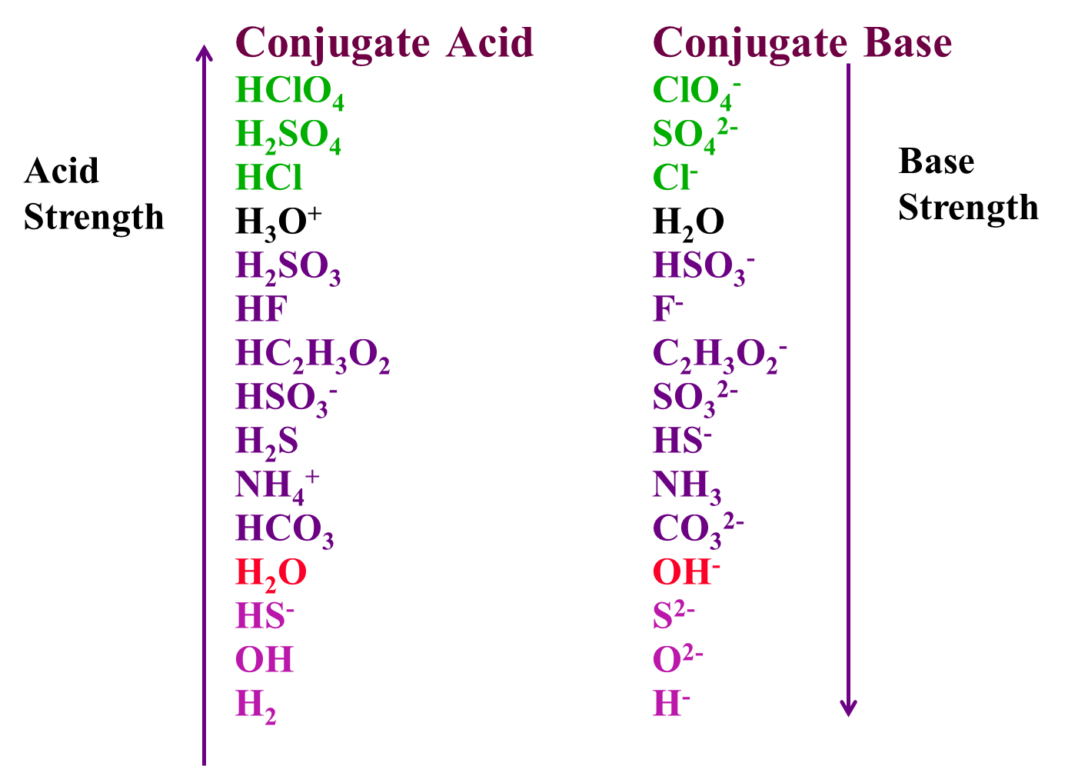
Acid-Base Equilibria
Brønsted Theory of Acids and Bases
  Acid
    Substance which donates a proton
  Base
    Accepts proton from another substance
NH₃ + HCl <--> NH₄⁺ + Cl⁻
H₂O + HCl <--> H₃O⁺ + Cl⁻
NH₃ + H₂O <--> NH₄⁺ + OH⁻
Remainder of acid is base
Complete reaction is proton exchange between sets
Extent of exchange based on strength
Water can act as solvent and reactant

Slide 19
Dissociation Constants
Equilibrium expression for the behavior of acid
HA + H₂O <--> A⁻ + H₃O⁺
Water concentration is constant
pK_{a}=-logK_{a}
Can also be measured for base
Constants are characteristic of the particular acid or base
Acid Formula K_{a}
Acetic HC₂H₃O₂ 1.8E-5
Carbonic H₂CO₃ 3.5E-7
HCO₃⁻ 5E-11
Phosphoric H₃PO₄ 7.5E-3
H₂PO₄⁻ 6.2E-8
HPO₄²⁻ 4.8E-13
Oxalic H₂C₂O₄ 5.9E-2
HC₂O₄⁻ 6.4E-5

Slide 20
Calculations
1 L of 0.1 M acetic acid has pH = 2.87
What is the pK_{a} for acetic acid
CH₃COOH + H₂O <--> CH₃COO⁻ + H₃O⁺
[CH₃COO⁻] = [H₃O⁺] =10^{-2.87}
pK_{a}=4.73

Slide 21
Buffers: Weak acids and bases
Weak acid or weak base with conjugate salt
Acetate as example
  Acetic acid, CH₃COONa
  CH₃COOH + H₂O <--> CH₃COO⁻ + H₃O⁺
  If acid is added
    hydronium reacts with acetate ion, forming undissociated acetic acid
  If base is added
    Hydroxide reacts with hydronium, acetic acid dissociates to replace reacted hydronium ion
large quantity
huge quantity
large quantity
small quantity

Slide 22
Buffer Solutions
Buffers can be made over a large pH range
Can be useful in controlling reactions and separations
  Buffer range
    Effective range of buffer
    Determined by pK_{a} of acid or pK_{b} of base
HA + H₂O <--> A⁻ + H₃O⁻
Write as pH
The best buffer is when [HA]=[A⁻]
  largest buffer range for the conditions
  pH = pK_{a} - log1
For a buffer the range is determined by [HA]/[A⁻]
  [HA]/[A⁻] from 0.1 to 10
  Buffer pH range = pK_{a} ± 1
  Higher buffer concentration increase durability

Slide 23
Hydrolysis Constants
Reaction of water with metal ion
  Common reaction
  Environmentally important
  Strength dependent upon metal ion oxidation state
2 H₂O <--> H₃O⁺ + OH⁻
  Water concentration remains constant, so for water:
  K_{w} = [H₃O⁺][OH⁻]= 1E-14 at 25°C
Metal ions can form hydroxide complexes with water
M^{z+} + H₂O <--> MOH^{z-1+} + H⁺
Constants are listed for many metal ion with different hydroxide amounts
  Database at: http://www.escholarship.org/uc/item/9427347g

